Slide 1
Usability Test Results
‘Add Prospect’ Button

Slide 2
Stipulations
When this metric was last measured in the late summer of 2013, it was found that approximately 17%, nearly a fifth of all L2L Users view the product at a resolution of 1024 x 768
1024 x 768 is the resolution of Apple’s iPad

Slide 3
Assumptions
According to Eric Broughton, turnaround times for leasing agents average 6 months, giving them precious little time to acquire an appropriate level of familiarity with the software needed to do their jobs.
Adding a Prospect represents core functionality.

Slide 4
Purpose of Test
Determine optimal size, placement and labeling of ‘Add Prospect’ button
Optimal is defined as follows:
User can reliably locate this button
User can locate this button quickly

Slide 5
Description of Test
20 anonymous subjects were shown a screen layout that featured a discrete size and location of the ‘Add Prospect’ button: In the Ribbon or the ARSEON.
20 other anonymous subjects were shown a screen layout that featured a different size and location of the ‘Add Prospect’ button: In the ARSEON only.

Slide 6
What instruction subjects received
You are a leasing agent beginning your day. Someone just called you and said they're thinking of renting an apartment in the building you work for. Such people are called "Prospects." You must now add a Prospect record in this application. Where would you click?

Slide 7
results
Ribbon vs. ARSEON

Slide 8
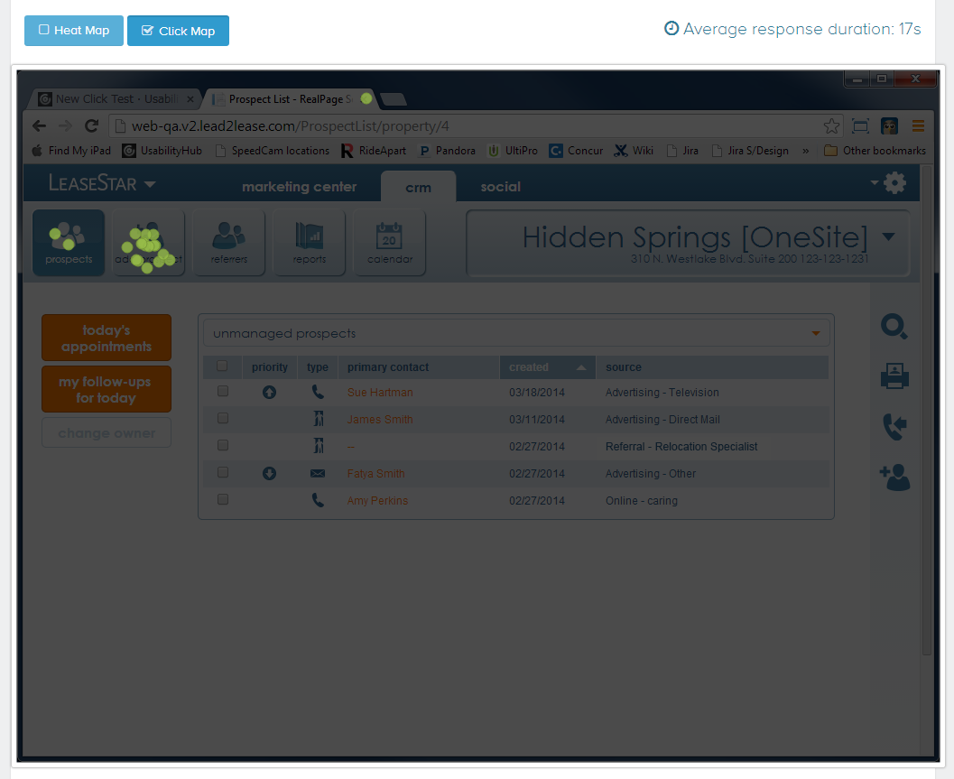
Add Prospect button in the Ribbon or ARSEON

Slide 9
Add Prospect button in the Ribbon or ARSEON
Average response time: 17 seconds
17 of 20 Users clicked correctly first time

Slide 10
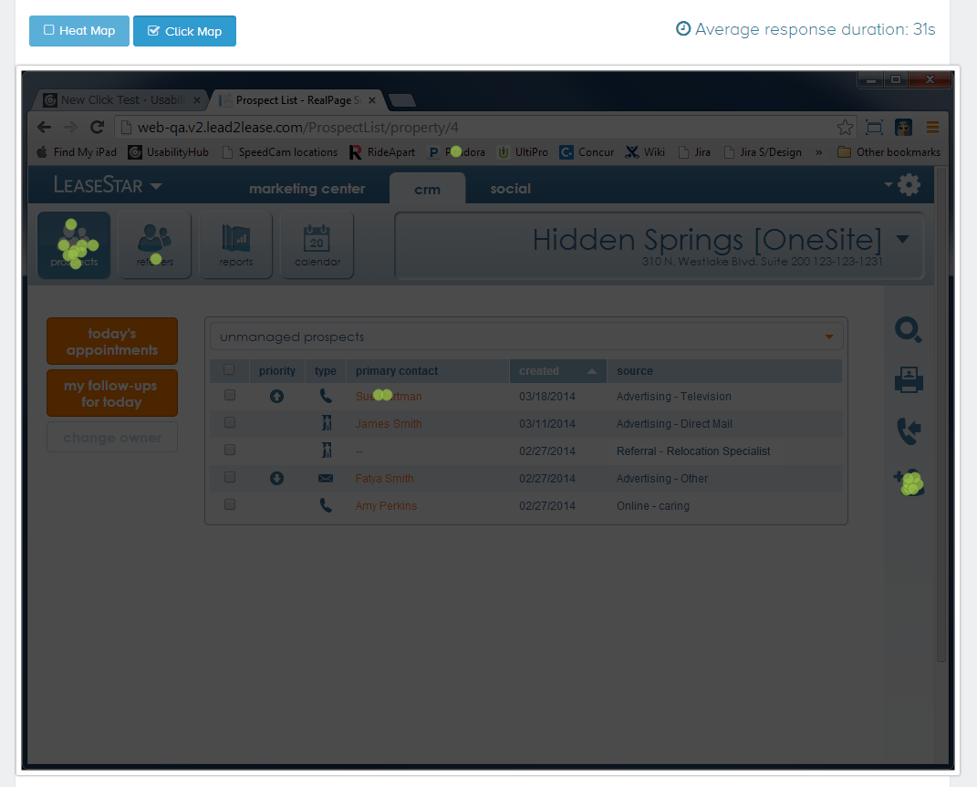
Add Prospect button in the ARSEON only

Slide 11
Add Prospect button in the ARSEON only
Average response time: 31 seconds
7 of 20 Users clicked correctly first time

Slide 12
Conclusion
Clearly, at 1024x768, the risk of Users not easily or quickly finding the ‘Add Prospect’ button has been confirmed.
Further testing is recommended:
For higher resolutions in which the labeling in the Right-Side Nav would be visible.
To determine that point at which training and/or habituation become mitigating factors.

